Slide 1
EUROPEAN GEOLOGICAL DATA INFRASTRUCTURE

Slide 2
Geological information for Europe:
Towards a pan-European Geological Data Infrastructure
European Geological
Data Infrastructure (EGDI)

Slide 3
Geological Information for ...
EUROPE needs
ENERGY
FOOD

Slide 4
NATURAL RESOURCES
WATER

Slide 5
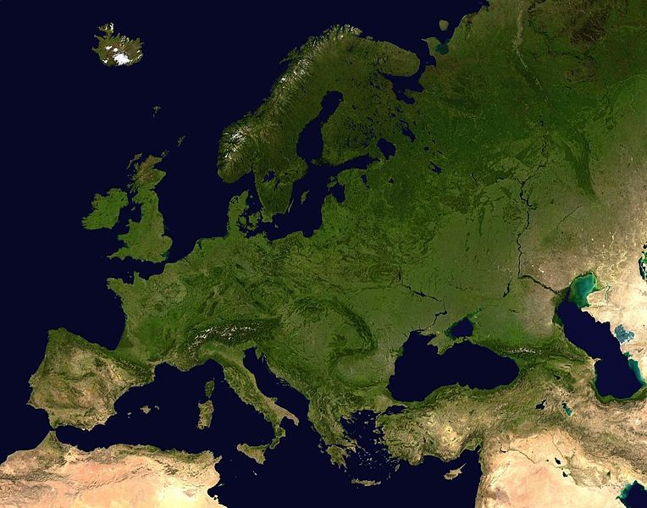
A e-Infrastructure for geological information at
EU-level
A collaboration of national Geological Surveys in Europe
EGDI is ...
A support for international stakeholders from policy, industry and research
A continuous access to interoperable and harmonized data

Slide 6
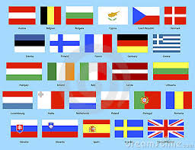
Scope of EGDI
EGDI
End users
End users
E-Infrastructure for geological information at EU-level, based on knowledge and data at national level
Services
Services
Information products
Information products
Data, maps, models
Interoperable/ harmonized data, maps, models
In-situ, ‘raw’ data
Country level
EU-level

Slide 7
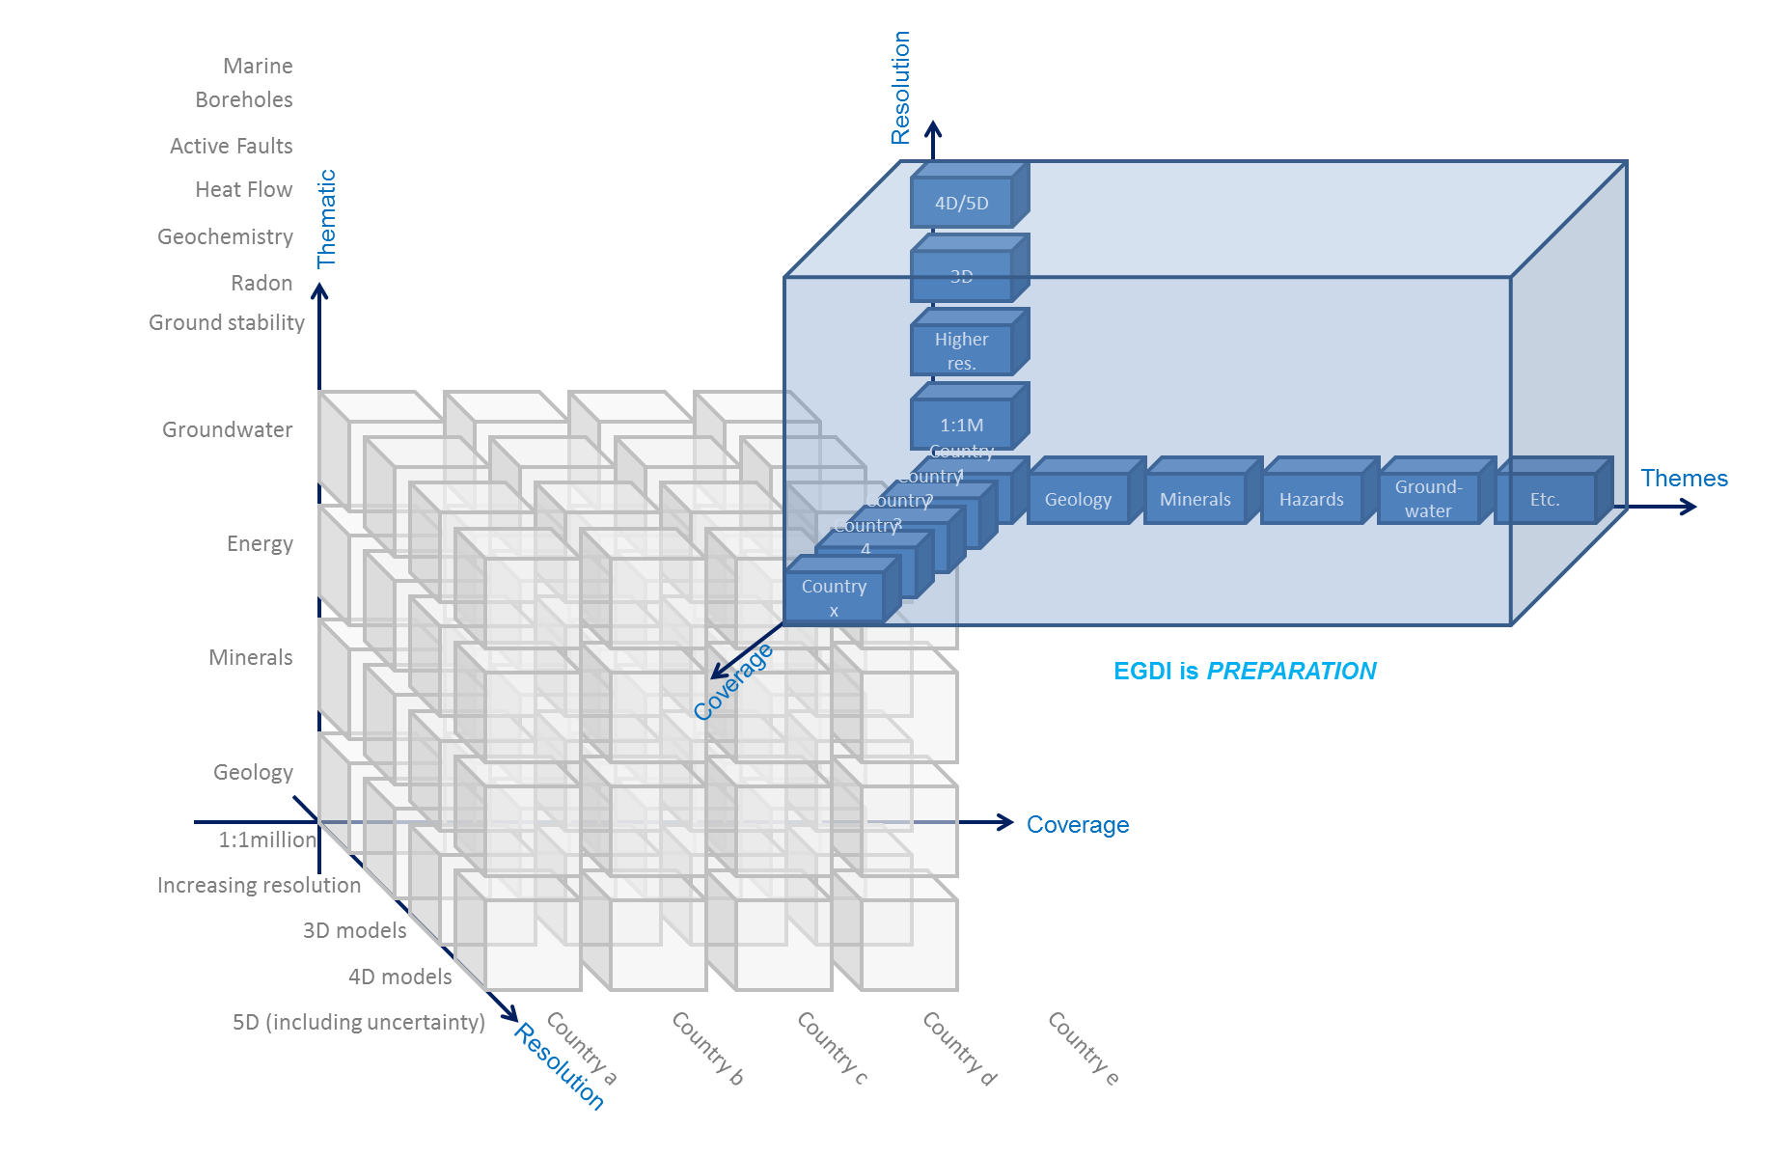
Scope of EGDI
Themes (on-/offshore):
Earth resources (energy, minerals)
Geohazards
(Ground-)water
Infrastructure/ Urban dev.
Soils/ Habitats
Etc.
Resolution:
Local, regional, (inter-) national scales
2D+, 3D+, 4D+, …
Data:
Public
Freely available
Charged?
Restricted?
EGDI priority
Coverage:
33 European countries
Notes:
- Organisational/ Governace structure reasonable?

Slide 8
Roadmap towards EGDI
2012 / 2014
Scoping (EGDI-Scope study)
2014
Design & implementation
Maintenance
&
Development
Extensions
Extensions
Extensions
Extensions
~ 2018
Extensions
202..
Maintain datasets and results from flagship EU-projects in geological domain
Building forward on INSPIRE and existing project results
Annual EGDI work program
INSPIRE/ standards
Licenses/ services/ tools/ hardware etc.
Contact point
Multiple (harmonization) projects in multiple domains
Tasks
Consortium/
representation all surveys
Project consortia/
EGDI operational structure
Governance
EGDI operational structure

Slide 9
EGDI
Stakeholder Consultation
Prioritisation of datasets & proposal of
methodologies
Requirements for technical design,
deployment, and maintenance
Legal and organisational aspects
Communication & Dissemination

Slide 10
STAKEHOLDERS
Identification: stakeholder panel & forum
Consultation: workshops, questionnaires & interviews
Needs and Requirements: Requirement Specification (data, functionality, integration)

Slide 11
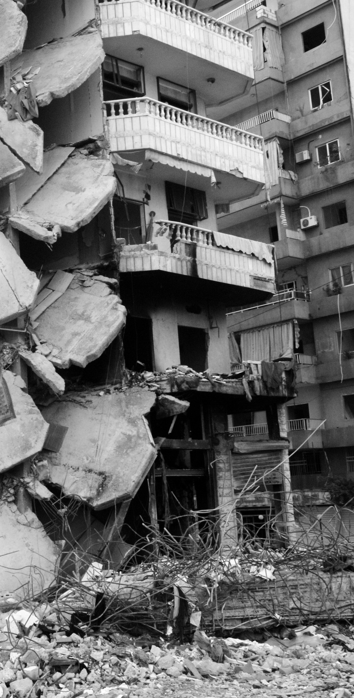
Use Cases
Geohazards: Ground instability in densely populated areas
Water: Natural background level of As in groundwater
Mineral Resources: Rare Earth Elements

Slide 12
Use Cases
ENVIRONMENT: Ecosystem mapping and assessment
GREEN ENERGY: Planning for offshore wind farms

Slide 13
Future Perspectives
Decisions regarding use cases to be supported in phase 1, 2, etc.
Assess user requirements in relation to;
Datasets
What is already available (phase 1)
What can be produced in short term (phase 2)
What can be produced in the long term (phase n)
Technical possibilities
Need-to-have functionality (phase 1)
Nice-to-have functionality (phase n)
Easy-to-satisfy requirements (phase 1)
Difficult-to-satisfy requirements (phase n)

Slide 14
Stakeholders needs
Stakeholders support and encourage a future EGDI
Real users do exist
There is an information gap for EGDI to fill
Non-expert users need easy accessible information
Expert users need advanced access to comprehensive datasets
Fulfilment of concrete use cases is essential
The key factors to future success are Content and Useability

Slide 15
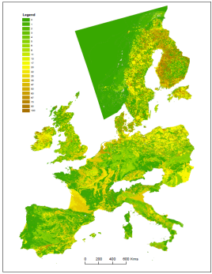
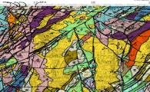
Prioritisation of datasets & proposal of methodologies
Inventory of projects
Over 80 European projects
Review of the data available within NGSO’s & other organisations
2000 datasets analysed

Slide 16
Prioritisation of datasets & proposal of methodologies
Implementation and prioritisation plan for rolling out datasets on the EGDI
Requirements for incorporating3D data

Slide 17
Future Perspectives
Need to sustain data from many previous projects
Significant investment in spatial/ environmental information across Europe has already been made (€100M’s)
Proposed new methodology incorporating baseline
geological map data e.g. 1G-E
E.g. Sand and gravel resources of Europe
Proposed methodology to combine ‘derived’ output data from previous projects
E.g. Subsidence map of Europe
Quick-wins: possibilities to incorporate datasets into the EGDI infrastructure

Slide 18
Prioritisation of datasets & proposal of methodologies
EGDI infrastructure can provide support for 5 key areas:
Preservation of methods
Options for harmonisation of disparate scale/scope data
Options for structured vocabularies
Options for cross-discipline research to develop new products relating geo-science impacts with multiple agendas
Options for managing the metadata of proxy/analogous datasets from across Inspire Annexes

Slide 19
Requirements for technical design, deployment, and maintenance
Existing infrastructures evaluation
Over 43 projects,
7 initiatives,
4 directives and framework documents analysed
⇨ Identification of recommended Topics / components
Data models,vocabularies, services, and portal specifications
Taking into account WP2 Use Cases
Recommendations to be followed for data models, vocabularies, services and metadata
⇨ Strong link recommended with INSPIRE

Slide 20
Requirements for technical design, deployment, and maintenance
Infrastructure needs
*in progress*
Direct link to WP2 user needs and functional requirements
Description using the ISO RM-ODP (Open Distributed Processing — Reference model)
Report on recommendations for implementation of EGDI*
in progress*
In parallel with EGDI implementation plan

Slide 21
Achievements
GEOSS like - infrastructure
A framework of recommended components (implemented by EGDI and projects)
and common components shared at European level
Client layer
EGDI Portal
Thematic Portals
Applications
EGDI Portal
Registries:
Components
Standards
Best practices
Vocabularies
Objects dictionary
Portrayal rules
…
Mediation layer
Portrayal services
Processing services
Catalogue
EGDI Catalogue
Access layer
Data
services
EGDI Brokers
(discovery, access, …)

Slide 22
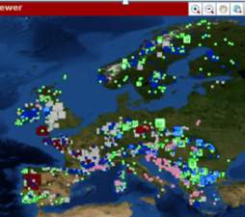
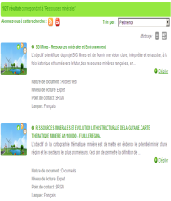
Requirements for technical design, deployment, and maintenance
Web Portals / Apps
On the right tracks
to set up a
pan-European
Geological
data infrastructure /
information
system
European level
European DB
Geological surveys
Web
Services
Web
Services
Web
Services
National level
Y…
Z…
X…

Slide 23
Legal and organisational aspects
Analysis of trust and authentication issues
Trust in data
Trust in services
Trust in people
Regulation and policies
Identification of legal & policy barriers to share & re-use data
Inventory of existing licensing policies
Licensor Licensee
Geo-Data/PSI

Slide 24
Legal and organisational aspects
Analysis of governance issues
*in progress*
General principles and requirements
Overview of technical, legal and organisational tasks
In parallel with EGDI implementation plan
Final guidelines
*in progress*
In parallel with EGDI implementation plan

Slide 25
Legal and organisational aspects
Guidelines are being developed for a legal and organisational framework for the open availability of geological data in the EGDI

Slide 26
Communication & Dissemination
To implement internal communication within the consortium.
To widely disseminate information on and progress of EGDI-Scope to all relevant stakeholders, with focus on EU bodies and the broad geoscientific community.

Slide 27
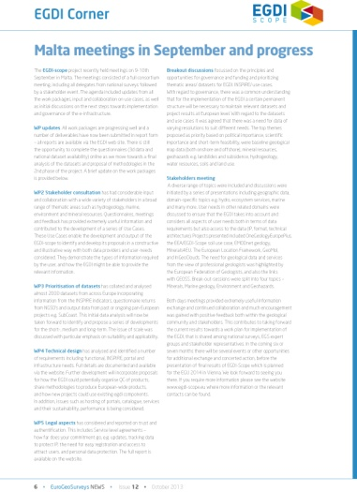
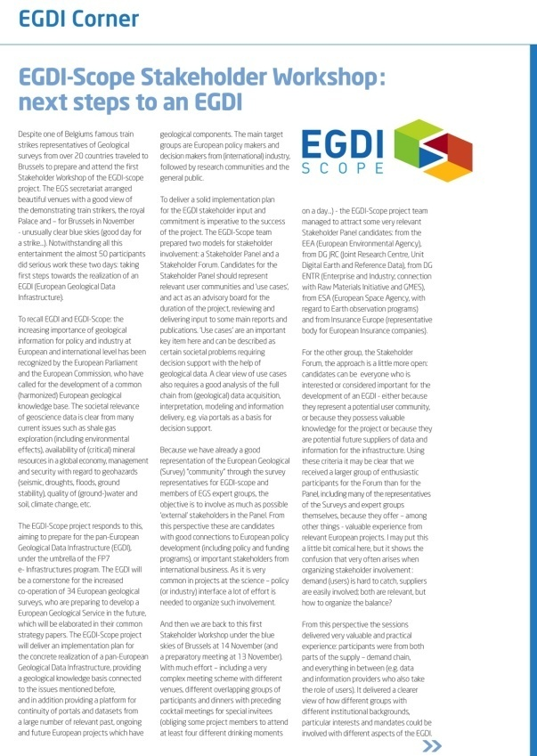
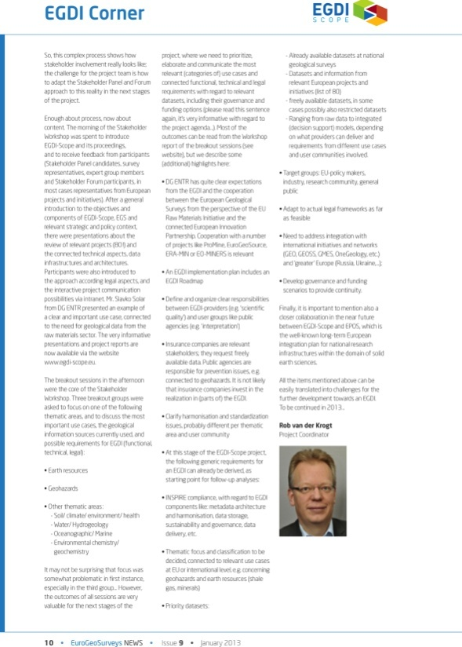
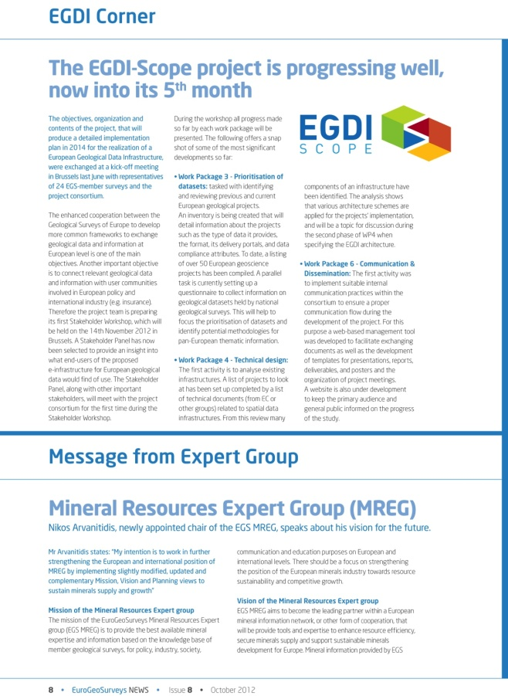
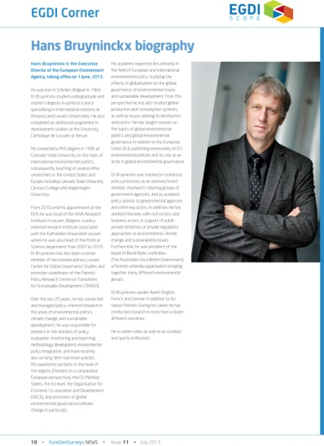
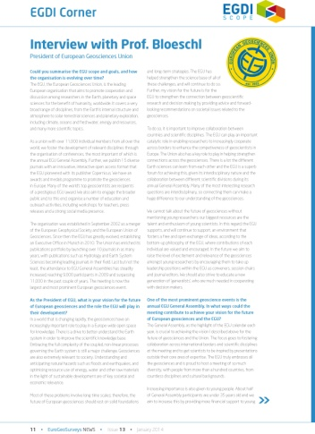
Internal Communication
Newsletter
Progress Meeting
Workshop

Slide 28
External Communication
Brochures 2013
Brochures 2014

Slide 29
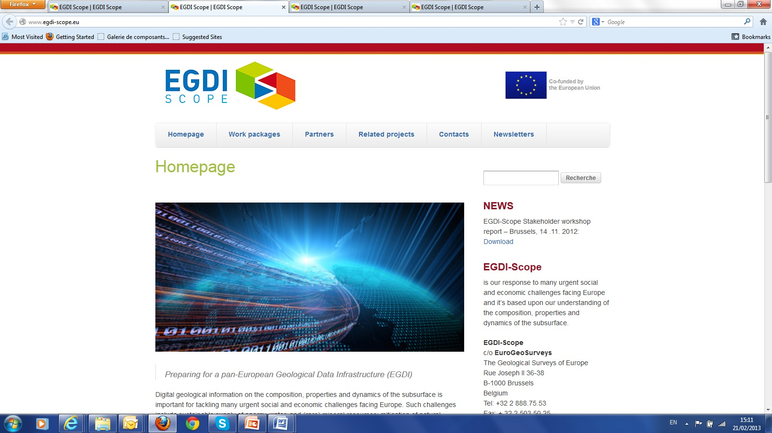
External Communication
Website
Banner

Slide 30
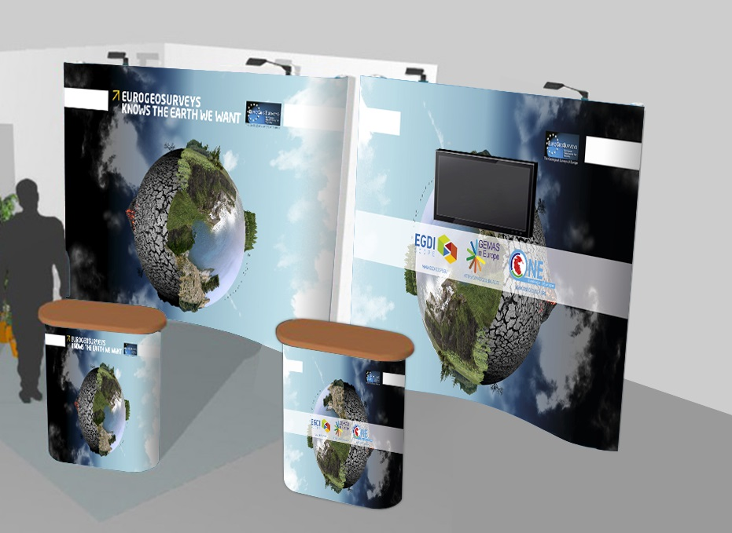
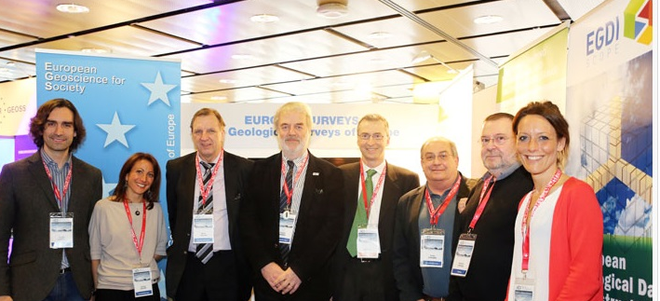
External Communication
Events

Slide 31
External Communication
Gadgets

Slide 32
EGDI will provide a sustainable platform and stimulate cross-topic collaboration encouraging expert groups to engage with other research disciplines and the public

Slide 33
EuroGeoSurveys is glad to invite you to EGDI Scope final event
EGDI-SCOPE.EU
EUROGEOSURVEYS.ORG
BRUSSELS
20 MAY 2014 at 17.00
Palais des Académies, Rue Ducale 1

